Slide 1
Day 17 - Graphs 2!
Prim’s/Dijkstra’s
Math 495R (Sec 9) - Competitive Coding

Slide 2
Business
Graphs 2 (Prim’s/Dijkstra’s) Problem Set Due Saturday
Big Programming Event - TBD
Rather have a big competition on a Saturday? Or an extended class period?

Slide 3
Announcement From CS Dept
The Qualtrics programming competition has been postponed (probably until Fall). However, I was recently made aware of the Mount Allison Programming Showdown, another programming contest (an inter-university ICPC style competition) happening the same day (next Saturday) at the same time (10am-3pm MDT). Details on the contest can be found here: https://www.maps.rocks/.
To facilitate/coordinate team forming (teams can have up to 3 people), I'm asking everyone to please fill out this quick form if you're reasonably confident that you'll be able to participate. Contests like this don't come around very often, and it can provide some great practice/experience. We'd love to have you join us!!!

Slide 4
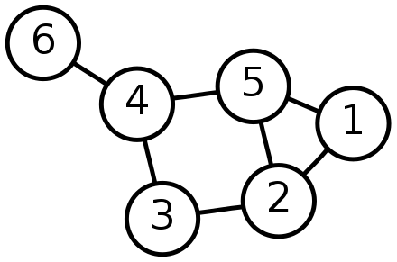
Graphs
Collection of Vertices and Edges
Directed/Undirected
When talking about runtime, use V and E
Typical Representations in Python:
Dictionary of Adjacency Lists
Adjacency Matrix
Graph Class

Slide 5
Minimum Spanning Tree
Given a graph, find the minimum total weight of edges that can connect all nodes.
Applications: City planning, road development, networks, etc.
Prim’s Algorithm!

Slide 6
Prim’s Algorithm
Initialize two sets, visited and unvisited. Add all nodes to unvisited. Pop your start node from unvisited and add it to visited.
Find the edge with the minimum weight that connects a node from visited to unvisited. Add that edge to the MST, and pop the new node from unvisited and add it to visited
Repeat 2 until no nodes are left unvisited.

Slide 7
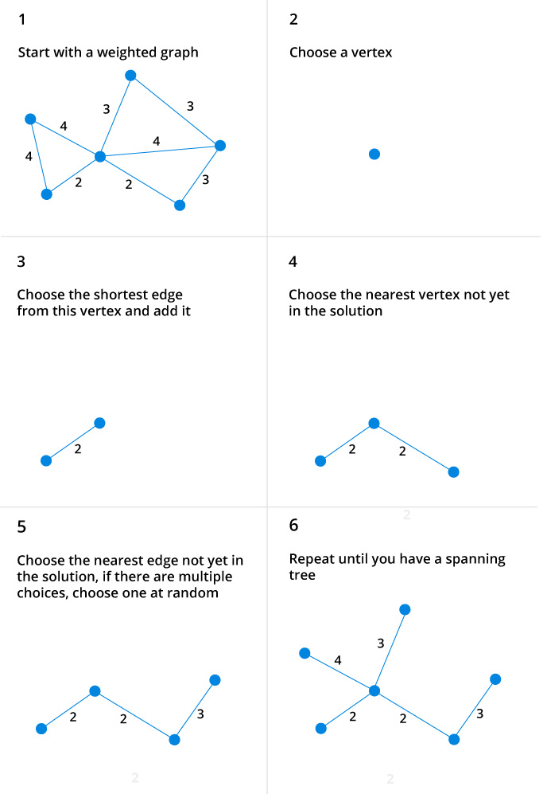

Slide 8
Minimum Distance to Each Node
Given a graph, find the minimum distance from a given node to all other nodes in the graph
Dijkstra’s Algorithm

Slide 9
